Slide 1
Overview of the ICC 500 ICC/NSSA Standard for the Design and Construction of Storm Shelters
Based on the 2015 International Codes®

Slide 2
Course description
The ICC 500 is a standard for the design and construction of storm shelters for protection from tornados and hurricanes. This course will review where storm shelters are required by the International building codes. There will also be an overview of the technical requirements, or the how to, requirements in the ICC 500.
The needs of the type of shelter differ because of the differences between tornadoes and hurricanes. Some of the biggest differences is the amount of warning time to get to a shelter, the time the occupants will stay in the shelter and the differences in the forces from the wind and debris on the shelter. This class will explain those differences and the why behind the requirements.

Slide 3
Goal
…determine the minimum technical requirements for storm shelters in.
2015 IBC.
2015 IRC.
ICC 500-2014: Standard for the Design and Construction of Storm Shelters

Slide 4
Objectives
Upon completion of this seminar, you will be better able to:
Identify where the ICC 500 is scoped in the codes
Determine the extent to which storm shelter standard provisions apply.
Identify scoping and technical requirements

Slide 5
Presentation organization
Title slides indicating topic/main code section
Performance requirements – Main ideas/ Philosophy
Code definitions or tables
Example
Quick questions on what we learned

Slide 6
Scoping

Slide 7
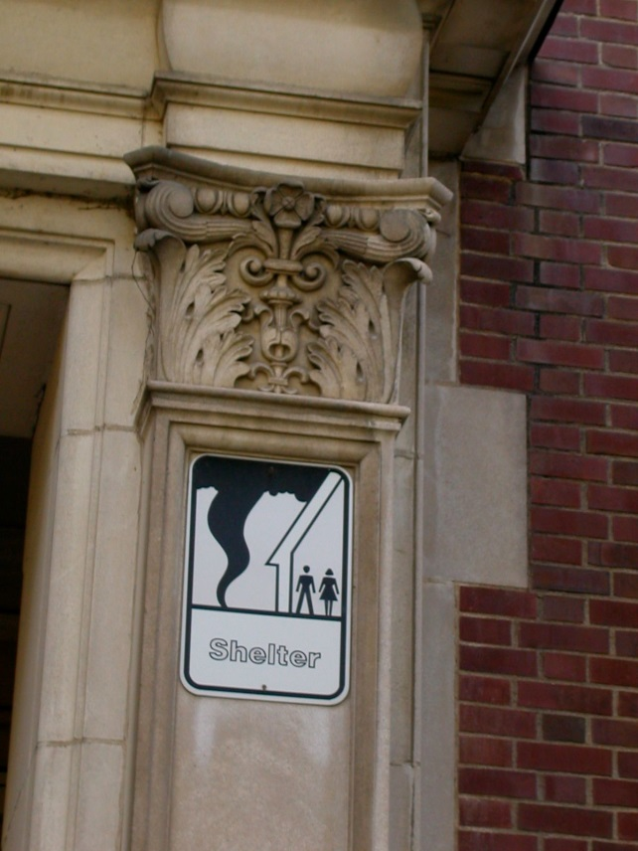
All referenced standards IBC Section 102.4
Considered part of the code to the extent referenced
Conflicts – codes rule
Notes:
[A] 102.4 Referenced codes and standards. The codes and standards referenced in this code shall be considered part of the requirements of this code to the prescribed extent of each such reference and as further regulated in Sections 102.4.1 and 102.4.2.
[A] 102.4.1 Conflicts. Where conflicts occur between provisions of this code and referenced codes and standards, the provisions of this code shall apply.
[A] 102.4.2 Provisions in referenced codes and standards. Where the extent of the reference to a referenced code or standard includes subject matter that is within the scope of this code or the International Codes listed in Section 101.4, the provisions of this code or the International Codes listed in Section 101.4, as applicable, shall take precedence over the provisions in the referenced code or standard.

Slide 8
IBC Definitions
[BS] STORM SHELTER. A building, structure or portions thereof, constructed in accordance with ICC 500 and designated for use during a severe wind storm event, such as a hurricane or tornado.
Community storm shelter. A storm shelter not defined as a “Residential storm shelter.”
Residential storm shelter. A storm shelter serving occupants of dwelling units and having an occupant load not exceeding 16 persons.

Slide 9
IBC
SECTION 423
STORM SHELTERS
2015 423.1 General. In addition to other applicable requirements in this code, storm shelters shall be constructed in accordance with ICC 500.
2018 423.2 Construction. In addition to other applicable requirements in this code, storm shelters shall be constructed in accordance with ICC 500. Buildings or structures that are also designated as emergency shelters shall also comply with Table 1604.5 as Risk Category IV structures.

Slide 10
IBC
2015 423.1.1 Scope. This section applies to the construction of storm shelters constructed as separate detached buildings or constructed as safe rooms within buildings for the purpose of providing safe refuge from storms that produce high winds, such as tornados and hurricanes. Such structures shall be designated to be hurricane shelters, tornado shelters, or combined hurricane and tornado shelters.
2018 423.1 General. This section applies to the construction of storm shelters constructed as separate detached buildings or constructed as rooms or spaces within buildings for the purpose of providing protection from storms that produce high winds, such as tornadoes and hurricanes during the storm. Such structures shall be designated to be hurricane shelters, tornado shelters, or combined hurricane and tornado shelters. Design of facilities for use as emergency shelters after the storm are outside the scope of ICC 500 and shall comply with Table 1604.5 as a Risk Category IV Structure.

Slide 11
IBC
2015 423.3 Critical emergency operations. In areas where the shelter design wind speed for tornados in accordance with Figure 304.2(1) of ICC 500 is 250 MPH, 911 call stations, emergency operation centers and fire, rescue, ambulance and police stations shall have a storm shelter constructed in accordance with ICC 500.
Exception: Buildings meeting the requirements for shelter design in ICC 500.
2018 IBC has removed the exception as unnecessary.

Slide 12
IBC
423.4 Group E occupancies. In areas where the shelter design wind speed for tornados is 250 MPH in accordance with Figure 304.2(1) of ICC 500, all Group E occupancies with an aggregate occupant load of 50 or more shall have a storm shelter constructed in accordance with ICC 500. The shelter shall be capable of housing the total occupant load of the Group E occupancy.
Exceptions:
1. Group E day care facilities.
2. Group E occupancies accessory to places of religious worship.
3. Buildings meeting the requirements for shelter design in ICC 500.
2018 IBC has created a separate section for capacity.
2018 IEBC will require storm shelters in additions to schools.

Slide 13
IBC
2018 423.4.1 Required occupant capacity. The required occupant capacity of the storm shelter shall include all of the buildings on the site and shall be the greater of the following:
1. The total occupant load of the classrooms, vocational rooms and offices in the Group E occupancy.
2. The occupant load of any indoor assembly space that is associated with the Group E occupancy.
Exceptions:
1. Where a new building is being added on an existing Group E site, and where the new building is not of sufficient size to accommodate the required occupant capacity of the storm shelter for all of the buildings on the site, the storm shelter shall at a minimum accommodate the required occupant capacity for the new building.
2. Where approved by the code official, the required occupant capacity of the shelter shall be permitted to be reduced by the occupant capacity of any existing storm shelters on the site.

Slide 14
IBC
2018 423.4.2 Location. Storm shelters shall be located within the buildings they serve or shall be located where the maximum distance of travel from not fewer than one exterior door of each building to a door of the shelter serving that building does not exceed 1,000 feet (305 m).

Slide 15
2018 IBC
TABLE 1604.5
RISK CATEGORY OF BUILDINGS AND OTHER STRUCTURES
Risk Category IV - Buildings and other structures designated as essential facilities, including but not limited to:
Designated earthquake, hurricane or other emergency shelters.
1604.10 Loads on storm shelters. Loads and load combinations on storm shelters shall be determined in accordance with ICC 500.
Notes:
Emergency shelter is for housing during or after an event.

Slide 16
2018 IBC
1604.5.1 Multiple occupancies. Where a building or structure is occupied by two or more occupancies not included in the same risk category, it shall be assigned the classification of the highest risk category corresponding to the various occupancies. Where buildings or structures have two or more portions that are structurally separated, each portion shall be separately classified. Where a separated portion of a building or structure provides required access to, required egress from or shares life safety components with another portion having a higher risk category, both portions shall be assigned to the higher risk category.
Exception: Where a storm shelter designed and constructed in accordance with ICC 500 is provided in a building, structure or portion thereof normally occupied for other purposes, the risk category for the normal occupancy of the building shall apply unless the storm shelter is a designated emergency shelter in accordance with Table 1604.5.
Notes:
Risk category does not have to go up if the tornado shelter is within another buildng

Slide 17
IRC
SECTION R323
STORM SHELTERS
R323.1 General. This section applies to storm shelters where constructed as separate detached buildings or where constructed as safe rooms within buildings for the purpose of providing refuge from storms that produce high winds, such as tornados and hurricanes. In addition to other applicable requirements in this code, storm shelters shall be constructed in accordance with ICC/NSSA-500.
Notes:
If you build a residential hurricane or tornado shelter, regardless of what you call it, it has to comply with ICC 500.

Slide 18
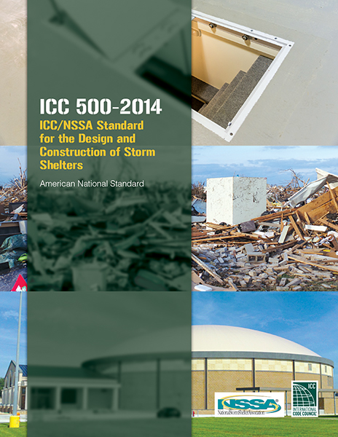
2014 ICC 500

Slide 19
Application
The purpose of the Storm Shelter standard is to provide design and construction requirements for ‘safe rooms’ that provide refuge from hurricanes and tornadoes.

Slide 20
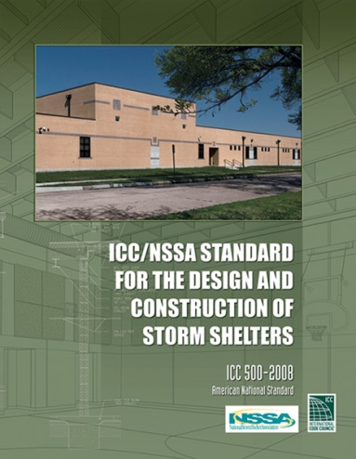
History/Development
Started in 2002 as joint project for ICC and the National Storm Shelter Association (NSSA)
First edition in 2008
5 year cycle
Balances committee
Open consensus process
ICC has a commentary for this standard

Slide 21
Types of storms
Tornado
Hurricane
Notes:
First a brief discussion on the differences between the types of storms, and then provide an overview of how these hazards are addressed in the standard.

Slide 22
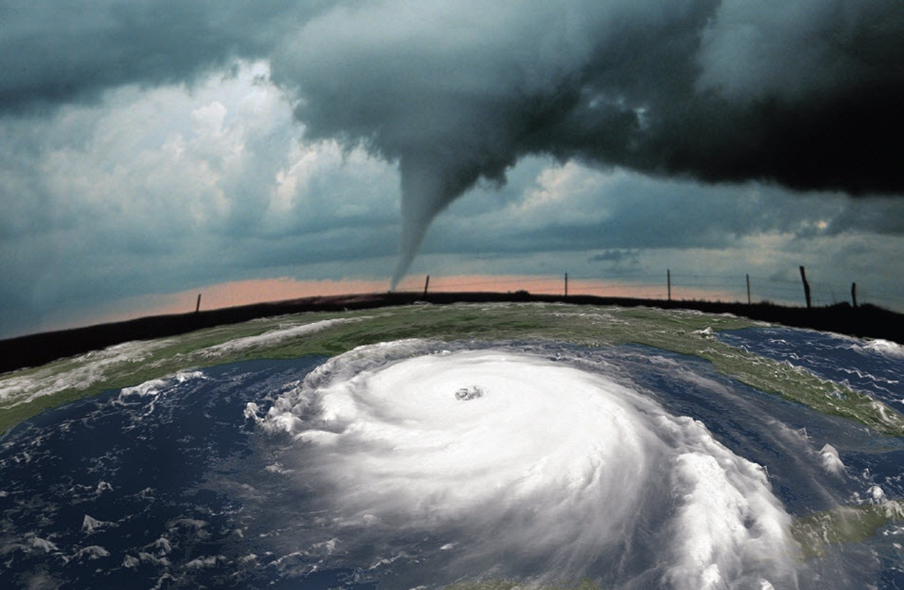
Hurricanes
A cyclonic wind circulation of the atmosphere around a low pressure center surrounded by strong winds and thunderstorms.
Form over warm water near the equator.
Regionally know as hurricanes, typhoon or tropical cyclone

Slide 23
The Saffir-Simpson Hurricane Wind Scale
Category | Sustained winds (mph) | Damage
One | 74-95 mph | Very dangerous winds will produce some damage
Two | 96-110 mph | Extremely dangerous winds will cause extensive damage
Three | 111-130 mph | Devastating damage will occur
Four | 131-155 mph | Catastrophic damage will occur
Five | greater than 155 mph | Catastrophic damage will occur

Slide 24
Hurricane facts
Hurricanes:
Hundreds of miles wide.
Form only over warm ocean water.
Last for days and sometimes well over a week.
Produce rain and flooding in addition to powerful winds.
Independent, self sustaining storm systems.
Winds ranging from 74 to about 200 mph
The hurricane season for the North Atlantic is June 1 through November 30.
Notes:
Hurricane records:
Largest: Igor, 2010, 902 miles in diameter
Longest duration: Ginger in 1971 and San Ciriaco in 1899 lasted 28 days
Hurricane with tornadoes: Ivan, 2004 with 117 tornadoes
Costliest: Katrina, 2005, $81.2 billion in damages

Slide 25
Tornadoes
Storm systems that form on land due to pressure differences.
Characterized by large rotating air columns, commonly shaped like funnels.
Can reach speeds over 300 mph before dissipating.
Most tornado deaths are from flying debris.

Slide 26
The Fujita Scale
Scale | Estimated wind Speed (mph) | Average Damage Path Width (meters) | Potential damage
F0 | 40–72 | 10–50 | Minor damage.
F1 | 73–112 | 30–150 | Moderate damage.
F2 | 113–157 | 110–250 | Considerable damage.
F3 | 158–206 | 200–500 | Critical damage.
F4 | 207–260 | 400–900 | Severe damage.
F5 | 261–318 | 1100 ~ | Total Destruction.
F6 | 319+ |  | Theoretical category. Immeasurable damage.
Note: the size of a tornado is not necessarily an indication of its intensity.
Notes:
Kim, are the colors necessary to indicate F0, F1, F2, etc? I can put them in.

Slide 27
Tornado facts
Tornadoes
Rarely over a mile wide
Usually form over land
Usually last minutes, rarely a few hours
Cause damage via wind and debris
Dependent on a large storm to develop and keep going
Winds range from 65 to about 300 mph
Often have a condensation funnel.
The tornado season runs from later winter through mid summer, however, tornadoes can happen all year.
The strongest tornadoes have faster winds than the strongest hurricanes.
Notes:
Tornado records:
Biggest outbreak: 147 tornadoes touched down in 13 U.S. states on 3 and April 4, 1974. The outbreak killed 310 in the U.S., 8 in Canada, with 5454 U.S. injuries and 23 hurt in Canada. 48 of the tornadoes were killers. Seven produced damage rated F5--the maximum possible--and 23 more were rated F4.
Deadliest/longest path/longest duration: The "Tri-state" tornado of March 18, 1925 killed 695 people as it raced along at 60-73 mph in a 219 mile long track across parts of Missouri, Illinois and Indiana, for over 3.5 hours, producing F5 damage.
Widest path: The Hallam, Nebraska F4 tornado of May 22, 2004 is the record-holder for peak width, at nearly two and a half miles
Costliest: The Topeka, Kansas tornado of June 8, 1966 is the current record holder, when adjusted for inflation, at $677 million in 2011 dollars.

Slide 28
Types of shelters
Shelters used for hurricanes
Shelters used for tornadoes
The primary difference in these two types is the expected duration of the storm.
Hurricane shelters – 24 hours
Tornado shelters – 2 hours

Slide 29
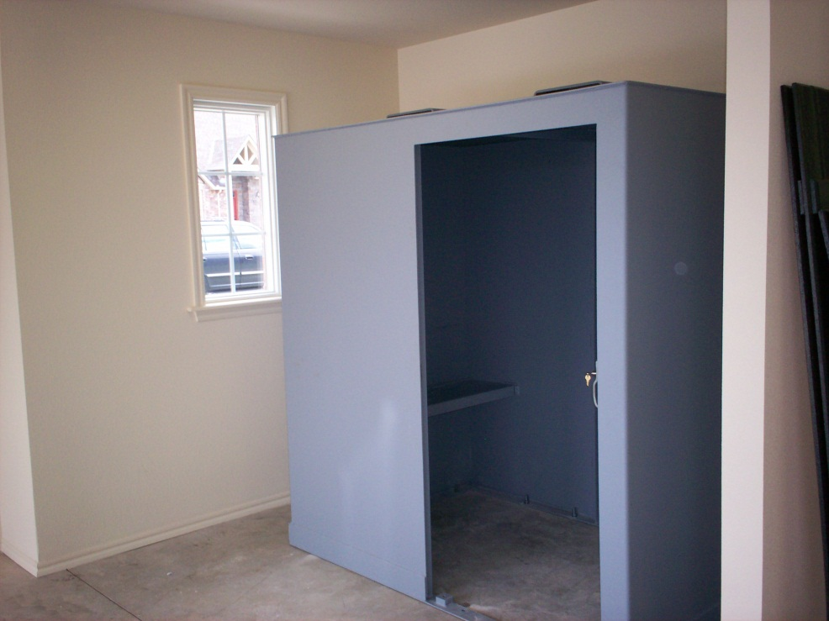
Types of shelters
What requirements differ between hurricane and tornado shelters?
Occupant density
Sanitation
Water supply
Ventilation
Emergency power
Size/speed of flying debris

Slide 30
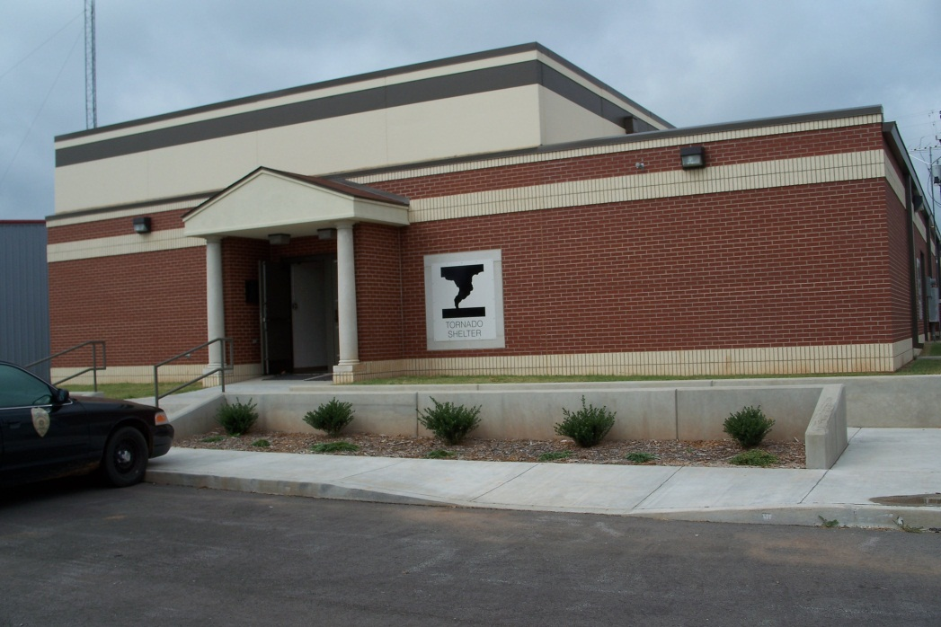
Types of shelters
Community shelters
Any shelter that is not a residential shelter
Residential shelters
Limited to 16 occupants maximum
Limited to residence or small group of residences

Slide 31
ICC 500 - 2014
Chapter 1: APPLICATION AND ADMINISTRATION
Chapter 2: DEFINITIONS
Chapter 3: STRUCTURAL DESIGN CRITERIA
Chapter 4: SITING
Chapter 5: OCCUPANCY, MEANS OF EGRESS, ACCESS AND ACCESSIBILITY
Chapter 6: FIRE SAFETY
Chapter 7: SHELTER ESSENTIAL FEATURES AND ACCESSORIES .
Chapter 8: TEST METHODS FOR IMPACT AND PRESSURE TESTING .
Chapter 9: REFERENCED STANDARDS

Slide 32
Application and Administration
Chapter 1

Slide 33
Scope, applicability and provisions for compliance
For tornado and hurricane shelters
Can be a separate structure or within another building
Provides minimum requirements via alternative compliance paths
Construction not addressed should comply with IBC

Slide 34
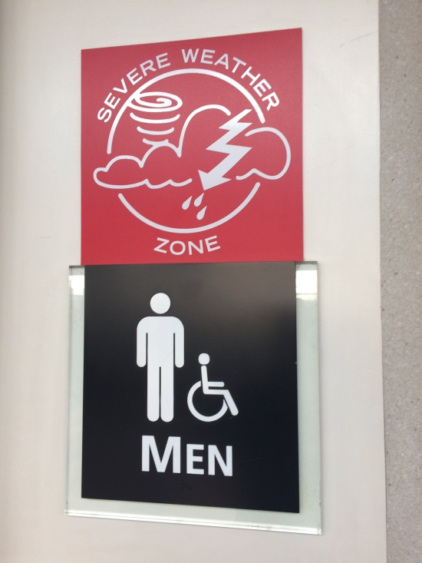
Occupancy Section 104
Shelters used for other purposes shall be the IBC Group for those occupancies.
Dedicated facilities with >=50 occupants is Group A-3
Dedicated facilities with <50 occupants is Group B

Slide 35
Inspections, foundations, design loads
The code official will inspect.
Peer review
Special inspections/Observations
Construction drawings
Labeling (FEMA P-361)

Slide 36
Chapter 2 Definitions

Slide 37
Definitions
Same as IBC Definitions.
STORM SHELTER. A building, structure or portions thereof, constructed in accordance with this standard, designated for use during a severe wind storm event, such as a hurricane or tornado.
Community storm shelter. Any storm shelter not defined as a “Residential storm shelter.”
Residential storm shelter. A storm shelter serving occupants of dwelling units and having an occupant load not exceeding 16 persons.

Slide 38
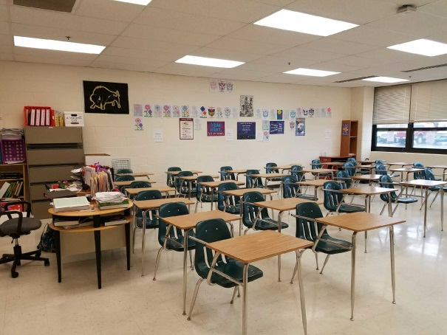
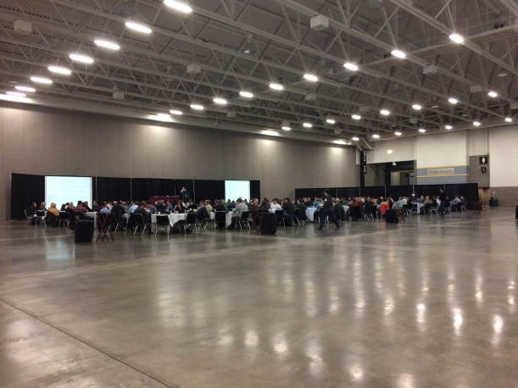
Definitions
AREAS OF CONCENTRATED FURNISHINGS.
Fixed furniture or partitions
AREAS OF UNCONCENTRATED FURNISHINGS.
Moveable furniture
AREAS OF OPEN PLAN FURNISHINGS.
Moveable furniture and no walls
Notes:
AREAS OF CONCENTRATED FURNISHINGS. The areas of a storm shelter with furniture or fixtures that cannot be moved easily, including areas such as bathrooms, locker rooms and rooms with fixed seating or fixed tables.
AREAS OF UNCONCENTRATED FURNISHINGS. The areas of a storm shelter with furniture or fixtures that can be
moved easily, including areas such as classrooms and offices.
AREAS OF OPEN PLAN FURNISHINGS. The areas of a storm shelter that are generally free of furniture or fixtures that cannot be moved easily and of interior partitions or other features that block movement through, or otherwise subdivide, the space.

Slide 39
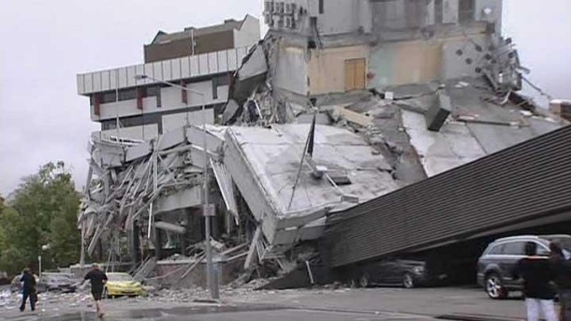
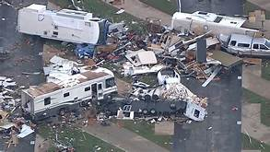
Definitions
HAZARDS.
Collapse. Debris from wind damage to adjacent, taller structures that could fall onto the shelter.
Laydown. Nearby structures such as towers or large trees that could fall onto the shelter, if the shelter is within the laydown radius of the structure.
Rollover. Vehicles and small buildings, such as temporary classroom buildings, that could roll over due to extreme winds and impact the shelter.

Slide 40
Definitions
IMPACT-PROTECTIVE SYSTEM. A system or device such as a shutter, door or other device mounted on the inside or outside of the exterior wall of a shelter that has been demonstrated by testing to be capable of withstanding the impact of test missiles as detailed in this standard.
REBOUND IMPACT. The rebound impact by a test missile, or fragments thereof, on a portion of the shelter protective envelope after the test missile has impacted another surface of the shelter protective envelope.

Slide 41
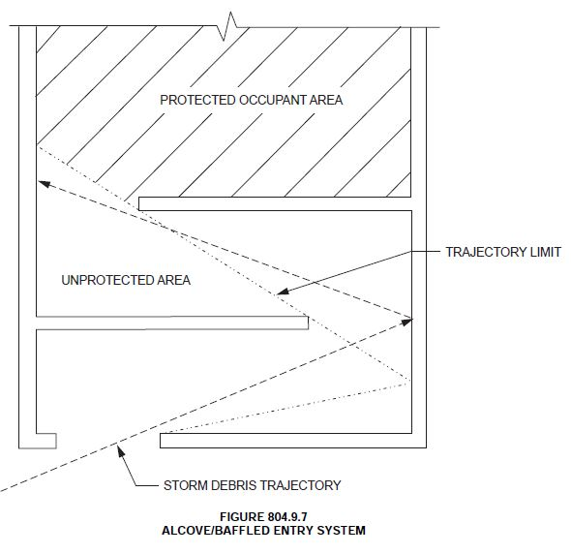
Definitions
PROTECTED OCCUPANT AREA.
SHELTER ENTRY SYSTEM, ALCOVE.
SHELTER ENTRY SYSTEM, BAFFLED.
SHELTER ENVELOPE. The protective walls, roofs, doors
and other protected openings that are designed to meet the
requirements of Chapter 3 to provide protection to occupants during a severe windstorm.

Slide 42
Chapter 3 – Structural Design Criteria Chapter 6 - Fire Safety

Slide 43
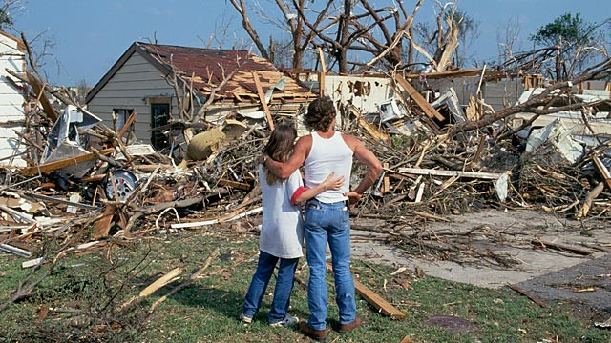
Application
Provides design requirements to resists high wind pressures and flying debris.

Slide 44
Application
Provide construction requirements for:
The main wind resisting structural system
Components and cladding.
Basic occupant life safety and health requirements

Slide 45
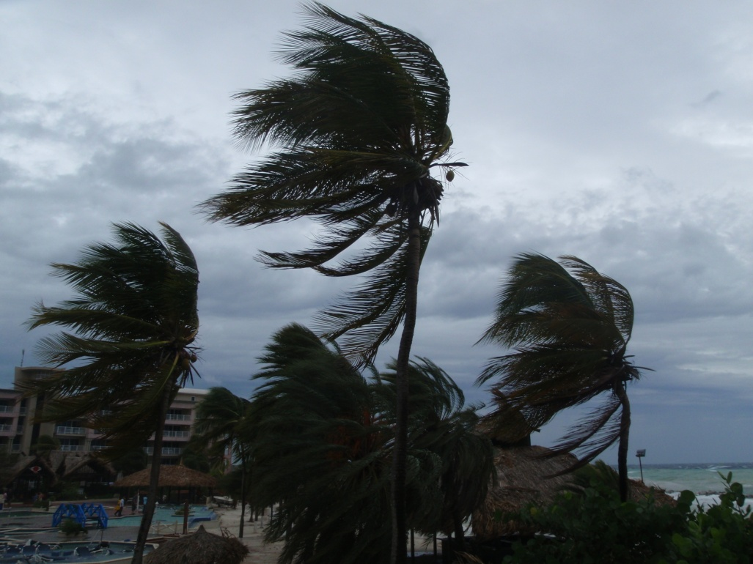
Structural Features
Water loads
Wind loads
Debris
Other concerns

Slide 46
Water loads
Rain loads
6” per hour in addition to rate in maps
Hydrostatic loads
Flood loads

Slide 47
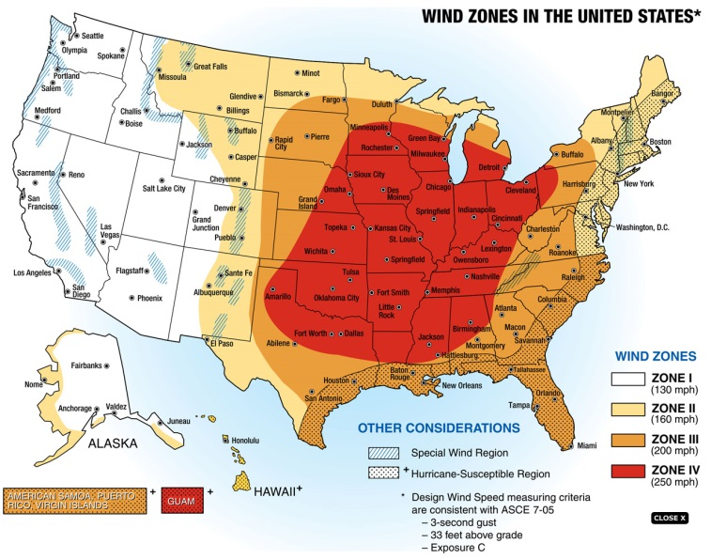
Wind loads
Wind load contour maps
Hurricanes
Atlantic coast and Gulf of Mexico
Hawaii, Puerto Rico, Guam and Virgin Islands
Tornado
Mid-west and eastern states
Alaska, American Samoa, Guam, Hawaii, Puerto Rice, Virgin Islands

Slide 48
Wind loads
Modifications to ASCE 7 Method 2
Wind directional factor, K_{d}
Importance factor, I
Exposure category
Topographic effects, K_{zt}
Enclosure classification
Atmospheric Pressure Change, APC

Slide 49
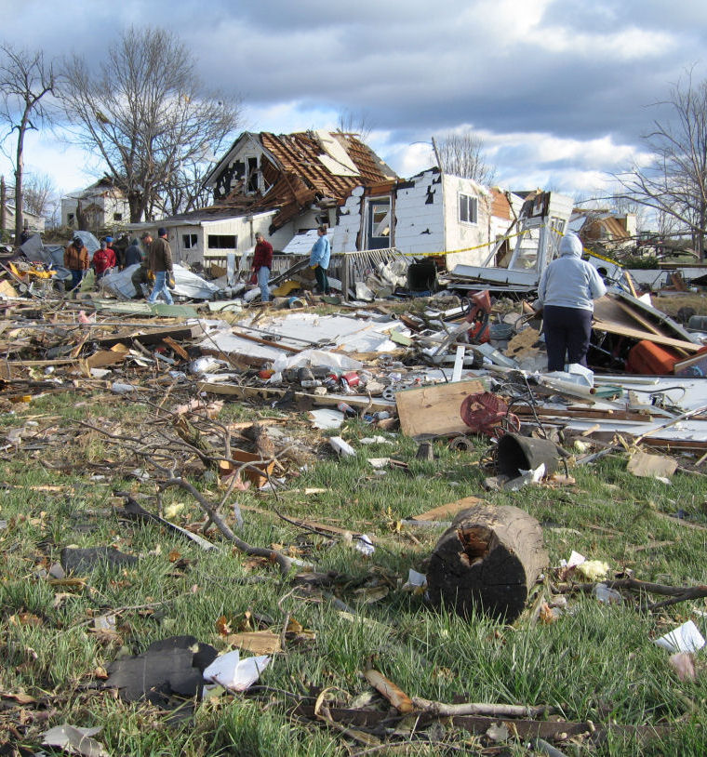
Debris
Research based on compact, rod and plate type missiles.
Test methodology for testing walls, doors, shutters, and windows for impact from flying debris
The debris missiles expected for tornadoes is considerably higher than hurricanes

Slide 50
Other structural issues
Component design and testing;
Weather protection;
Enclosure within a ‘host’ building;
Connection of the shelter to foundations or slabs;
Penetration of the shelter envelope by systems and utilities.

Slide 51
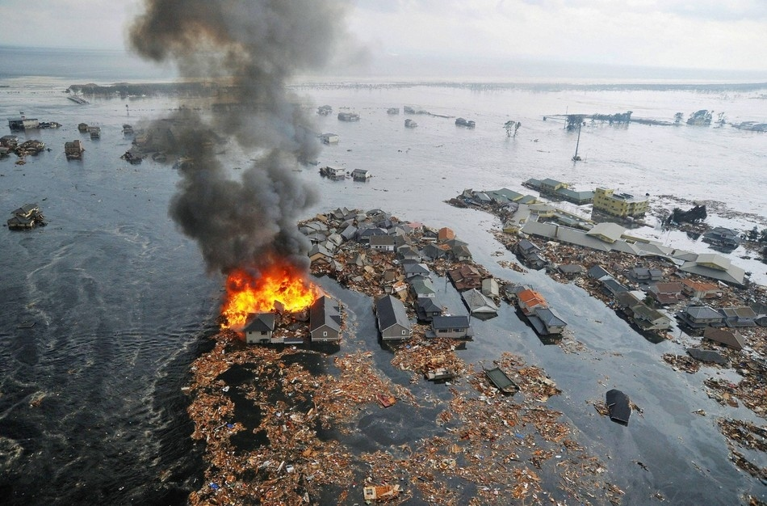
Other structural issues
Because fires often break out during or after a storm, where IBC requires fire barriers and horizontal assemblies with a fire-resistance-rating, where this is also a shelter wall or ceiling, it must be at least 2 hours.
Notes:
Bring up alternative interpretations

Slide 52
Chapter 4 Siting

Slide 53
Travel distance
IBC says commercial tornado shelters at schools have to be within the building or less than 1000’ from an exterior door of the building to the door of the shelter (IBC Section 423.4.2)
ICC 500 says residential shelter have to be within the building or less than 150’ from an exterior door of the home to the door of the shelter (ICC 500 Section 403)

Slide 54
Flood provisions
Both commercial and residential shelters have to be elevated to limit the chance of flooding
Option differ based on if this is a tornado or hurricane, commercial or residential
Hurricane shelter will consider storm surge and costal wave effects
Considerations may include
2’ above the 100 year flood elevation and
Above the 500 year flood elevation
Above the highest recorded floor elevation

Slide 55
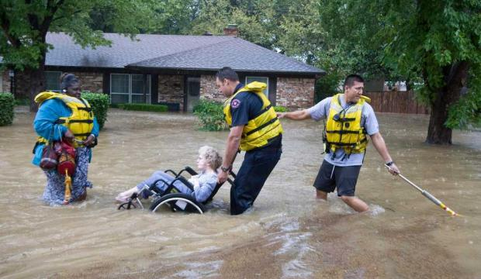
Safety provisions
Shelters must be protected from the possible release of any high hazard materials in the building
Shelters must not be located in Costal V zones on in the Floodway.

Slide 56
Chapter 5 - Occupancy, Means of Egress and Accessibility Chapter 7 - Shelter essential features and accessories

Slide 57
Application
Basic occupant life safety and health requirements include:
Accessibility
Means of egress
Lighting
Sanitation
Ventilation
Fire Safety
Minimum required floor space per occupants

Slide 58
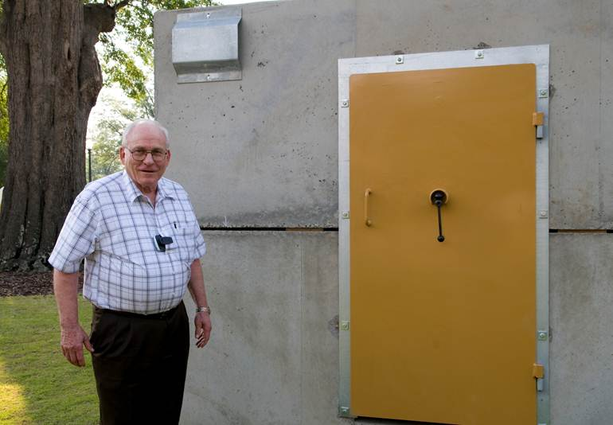
Essential Features
Occupant density
Number of doorways
Emergency escape
Ventilation
Potable water and sanitation
Emergency features
Location
Accessibility

Slide 59
Occupant Density
Community shelters
Hurricanes
20 sq.ft. per person
Wheelchair – 20 sq.ft.
Bedridden – 40 sq.ft.
Tornadoes
5 sq.ft. per person
Wheelchair – 10 sq.ft.
Bedridden – 30 sq.ft.

Slide 60
Occupant Density
Residential shelters
One- and two- family residential shelters
Hurricanes 7 sq.ft. per person
Tornadoes 3 sq.ft. per person
Larger residential shelters
Hurricanes 10 sq.ft. per person
Tornadoes 5 sq.ft. per person

Slide 61
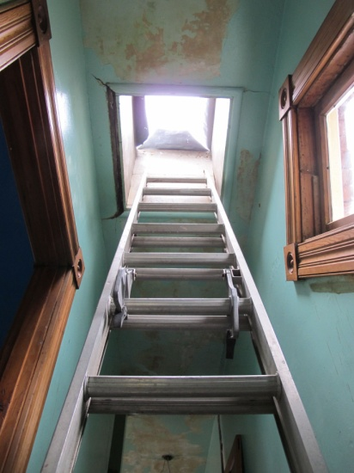
Number of doorways & Emergency Escape
Number of exits for primary occupancy during normal use, not the occupant load of the shelter
When a community shelter has a single exit, a 2nd emergency escape opening is required

Slide 62
Ventilation
Minimum ventilation openings required
Based on:
Tornado or hurricane shelter
Residential or community
Occupant load of community shelter greater than 50

Slide 63
Potable water and sanitation facilities
Toilet facilities higher for hurricane shelters due to length of stay
Can use toilets within shelter if they can be converted for emergency mode
Toilets can be chemical toilets.
Hurricane shelters must have supply and storage for potable and waste water.

Slide 64
Emergency features
Tornado shelters
Fire extinguishers, first aid kits
Community shelter must have emergency lighting
Hurricane shelters
Fire extinguishers, first aid kits, emergency lighting
Community shelters with greater than 50 occupants must have standby power and lighting

Slide 65
Location & Accessibility
Community shelters must be on an accessible route
Residential shelters can be accessed by a stairway, ladder or alternating tread device

Slide 66
Chapter 8 Test methods for impact and pressure testing

Slide 67
Testing Protocol
Impact testing
Pressure testing

Slide 68
Chapter 9 Referenced standards

Slide 69
Referenced Standards
The full name of any standards referenced in the text, the edition and information on the promulgator are found in Chapter 6.
If you look up a standard, you will also see the section where that standard is referenced.

Slide 70
Summary
Building codes require that buildings be able to withstand a “design” wind event.
Most tornado-prone regions, the building code design wind event is a wind event with 90 mph winds.
Hurricane-prone areas, design wind events in the code range from 90 to 150 mph.
A tornado or extreme hurricane can cause winds much greater than those on which local code requirements are based.
Having a home built to “code” does not mean that your home can withstand wind from an extreme weather event.
Notes:
Kim: This and the next slide are a little text heavy…would like to summarize the bullet points more.

Slide 71
Summary
Home or small business owners should assess their risk and determine the best type of safe room for their needs.
A safe room is the preferred method of wind protection in high-risk areas.
IBC Section 423 does not require storm shelters in most occupancies, but does require compliance with ICC 500 if someone wants to build a shelter.
Storm shelters are required in schools and buildings housing people we need for emergency response after the storm

Slide 72
Summary
Having a shelter can reduce injury and death.
Evacuation plans must be made known and practiced.

Slide 73
Is your area in tornado alley?

Slide 74
Would a tornado shelter be required?
Notes:
No, not in an emergency care center or emergency room in a hospital. Required in emergency operation centers.

Slide 75
Would a hurricane shelter be required?
Notes:
No – tornado shelters are required in fire stations in the tornado belt, but there is no requirement for hurricane shelters.

Slide 76
Your comments?
What in this section might you be able to use in your own work?
What could you best share with others in as part of a collaborative effort?

Slide 77
International Code Council is a Registered Provider with The American Institute of Architects Continuing Education Systems. Credit earned on completion of this program will be reported to CES Records for AIA members. Certificates of Completion for non-AIA members are available on request. This program is registered with the AIA/CES for continuing professional education. As such, it does not include content that may be deemed or construed to be an approval or endorsement by the AIA of any material of construction or any method or manner of handling, using, distributing, or dealing in any material or product. Questions related to specific materials, methods, and services will be addressed at the conclusion of this presentation.

Slide 78
Copyright Materials
This presentation is protected by US and International Copyright laws. Reproduction, distribution, display and use of the presentation without written permission of the speaker is prohibited.
© International Code Council 2015

Slide 79
Thank you for participating
To schedule a seminar, contact:
The ICC Training & Education Department
1-888-ICC-SAFE (422-7233) Ext. 33818
or
E-mail: icctraining@iccsafe.org

